Slide 1
CT4029 Principles of Programming Day 5 – Session 9 Arrays and Data Visualization

Slide 2
Learning Outcomes
Numpy Arrays
How Numpy arrays work
Difference between arrays and lists
Numpy operations
Data manipulation
Data Visualisation through Matplotlib
Graphs using defined data
Graphs using data from arguments
Graphs using external files
Types of plots

Slide 3
Today’s Agenda!
Numpy library and its functionalities
Matplotlib for data visualisation

Slide 4
Numpy library and its functionalities

Slide 5
Scientific Python?
Extra features required:
fast, multidimensional arrays
libraries of reliable, tested scientiﬁc functions
plotting tools
5
Notes:
5

Slide 6
Overview of NumPy
N-D ARRAY (NDARRAY)
UNIVERSAL FUNCTIONS (UFUNC)
N-dimensional array of rectangular data
Element of the array can be C-structure or simple data-type.
Fast algorithms on machine data-types (int, float, etc.)
Functions that operate element-by-element and return result
Fast-loops registered for each fundamental data-type
sin(x) = [sin(x_{i}) i=0..N]
x+y = [x_{i} + y_{i} i=0..N]

Slide 7
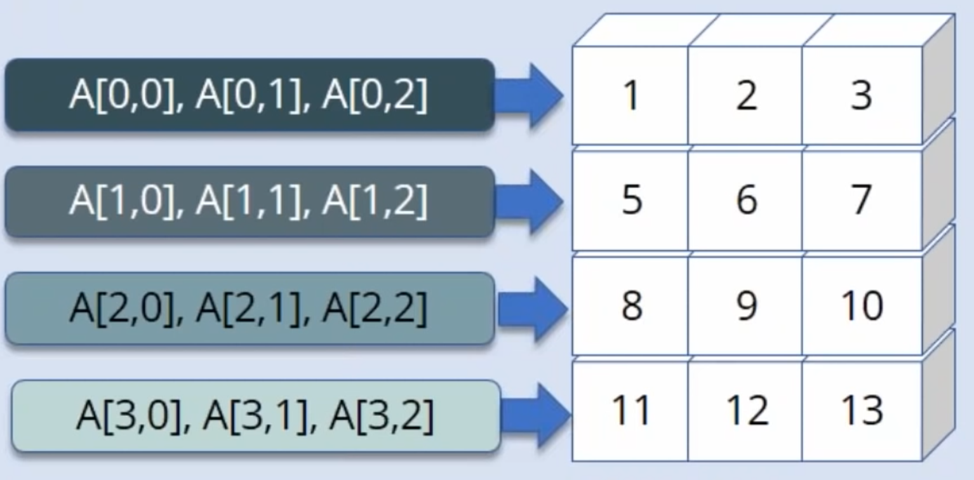
Numpy – Multidimensional Array
Numpy provides high-performance, multidimensional array object and tools for working with such arrays

Slide 8
Universal Function
A universal function (or ufunc for short) is a function that operates on ndarrays in an element-by-element fashion, supporting array broadcasting, type casting, and several other standard features. That is, a ufunc is a “vectorized” wrapper for a function that takes a fixed number of specific inputs and produces a fixed number of specific outputs.

Slide 9
NumPy Array
A NumPy array is an N-dimensional homogeneous collection of “items” of the same “kind”. The kind can be any arbitrary structure and is specified using the data-type.

Slide 10
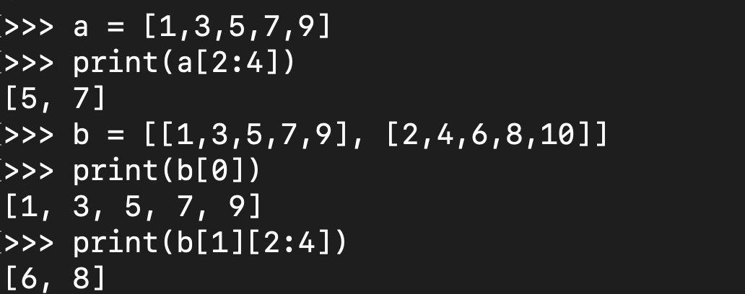
Arrays – Numerical Python (Numpy)
Lists ok for storing small amounts of one-dimensional data
>>> a = [1,3,5,7,9]
>>> b = [3,5,6,7,9]
>>> c = a + b
>>> print( c )
[1, 3, 5, 7, 9, 3, 5, 6, 7, 9]
But, can’t use directly with arithmetical operators (+, -, *, /, …)
Need efﬁcient arrays with arithmetic and better multidimensional tools
Numpy
Similar to lists, but much more capable, except ﬁxed size
>>> import numpy as np
Notes:
10

Slide 11
Numpy – N-dimensional Array manipulations
The fundamental library needed for scientific computing with Python is called NumPy. This Open Source library contains:
A powerful N-dimensional array object
Advanced array slicing methods (to select array elements)
Convenient array reshaping methods
It even contains 3 libraries with numerical routines:
Basic linear algebra functions
Basic Fourier transforms
Sophisticated random number capabilities
NumPy can be extended with C-code for functions where performance is highly time critical.
NumPy is a hybrid of the older NumArray and Numeric packages, and replaces them both

Slide 12
Numpy - ndarray
NumPy's main object is the homogeneous multidimensional array called ndarray.
This is a table of elements (usually numbers), all of the same type, indexed by a tuple of positive integers. Typical examples of multidimensional arrays include vectors, matrices, images and spreadsheets.
Dimensions usually called axes, number of axes is the rank
>>> a = np.array([1,3,5,7,9])
>>> b = np.array([2,4,6,8,10])
>>> c = a + b
>>> print(c)
[3 7 11 15 19]
[7, 5, -1] An array of rank 1 i.e. It has 1 axis of length 3
[ [ 1.5, 0.2, -3.7] , An array of rank 2 i.e. It has 2 axes, the first
[ 0.1, 1.7, 2.9] ] length 3, the second of length 3 (a matrix with 2 rows and 3 columns)
Notes:
12

Slide 13
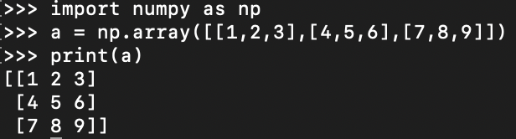
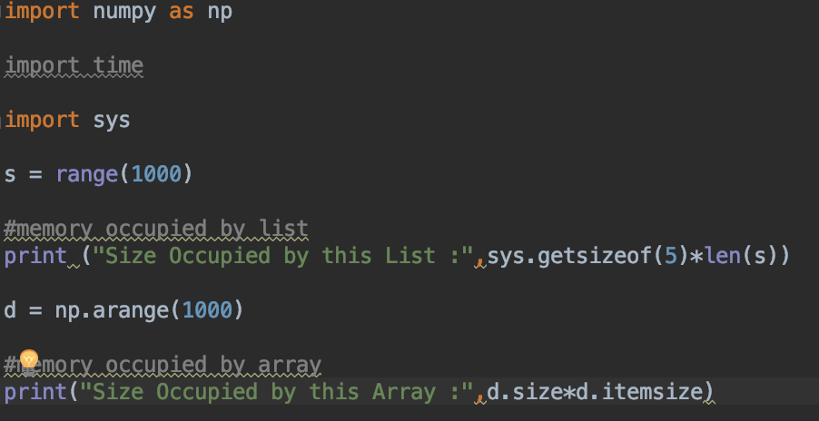
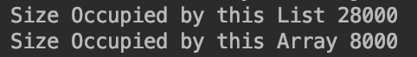
Numpy – Creation and Use – Multidimensional Array
Creating a multidimensional array
Why use numpy array instead of lists
It is faster than lists
Requires less memory
Convenient to manage and operate
Notes:
13

Slide 14
Numpy – ndarray attributes
ndarray.ndim
the number of axes (dimensions) of the array i.e. the rank.
ndarray.shape
the dimensions of the array. This is a tuple of integers indicating the size of the array in each dimension. For a matrix with n rows and m columns, shape will be (n,m). The length of the shape tuple is therefore the rank, or number of dimensions, ndim.
ndarray.size
the total number of elements of the array, equal to the product of the elements of shape.
ndarray.dtype
an object describing the type of the elements in the array. One can create or specify dtype's using standard Python types. NumPy provides many, for example bool_, character, int_, int8, int16, int32, int64, float_, float8, float16, float32, float64, complex_, complex64, object_.
ndarray.itemsize
the size in bytes of each element of the array. E.g. for elements of type float64, itemsize is 8 (=64/8), while complex32 has itemsize 4 (=32/8) (equivalent to ndarray.dtype.itemsize).
ndarray.data
the buffer containing the actual elements of the array. Normally, we won't need to use this attribute because we will access the elements in an array using indexing facilities.
Notes:
14

Slide 15
Numpy – Operations – Reshaping & Slicing
8 | 9 | 10
11 | 12 | 13
8 | 9
10 | 11
12 | 13
Reshape
8 | 9
10 | 11
12 | 13
9 | 11
Slicing
Notes:
15

Slide 16
Numpy – Operations – Reshaping & Slicing
import numpy as np
a = np.array([(1,2,3,4), (3,4,5,6)])
a = a.reshape(4,2)
print(a)
[[1 2]
[3 4]
[3 4]
[5 6]]
b = np.array([(1,2,3,4), (3,4,5,6)])
print(b[0,2])
3
c = np.array([(1,2,3,4), (3,4,5,6), (5,6,7,8)]) print(c[0:,3])
print(c[0:2,3])])
[4 6 8]
[4 6]
Notes:
16

Slide 17
Numpy – Array Creation and Use
>>> import numpy as np
>>> l = [[1, 2, 3], [3, 6, 9], [2, 4, 6]] # create a list
>>> a = np.array(l) # convert a list to an array
>>> print(a)
[[1 2 3]
[3 6 9]
[2 4 6]]
>>> a.shape
(3, 3)
>>> print(a.dtype) # get type of an array
int32
>>> print(a[0]) # this is just like a list of lists
[1 2 3]
>>> print(a[1, 2]) # arrays can be given comma separated indices
9
>>> print(a[1, 1:3]) # and slices
[6 9]
>>> print(a[:,1])
[2 6 4]
Notes:
17

Slide 18
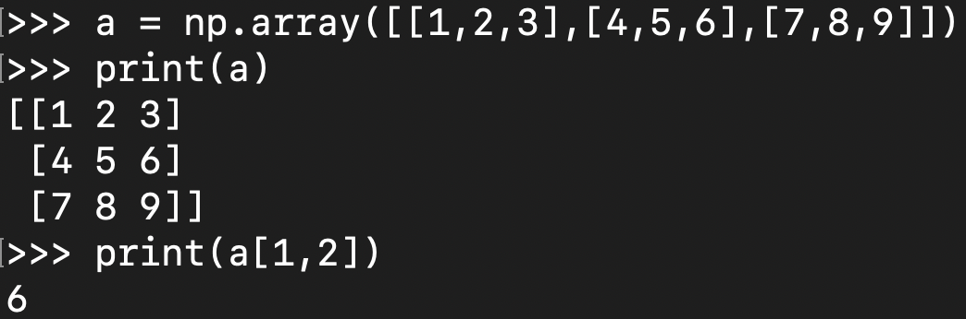
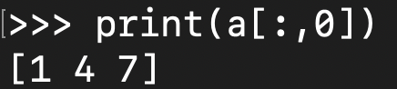
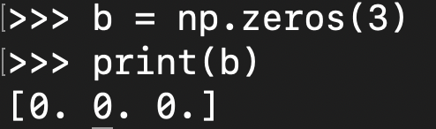
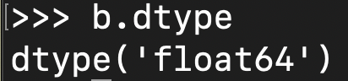
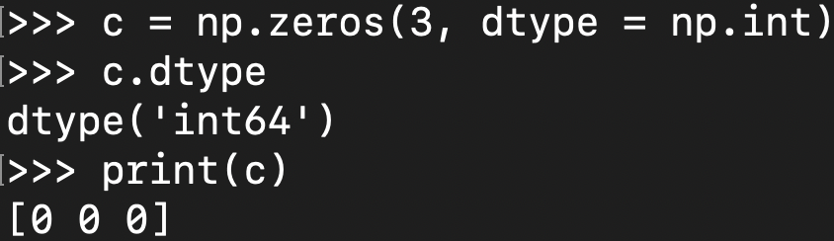
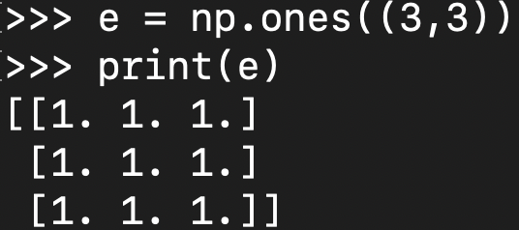
Numpy – array creation and use
Key Operations:
Browsing through elements of an array
Slicing the specific columns
Generating one dimensional array of ones or zeros
Changing the default datatype of auto generated arrays
Generating multidimensional array of ones or zeros
Notes:
18

Slide 19
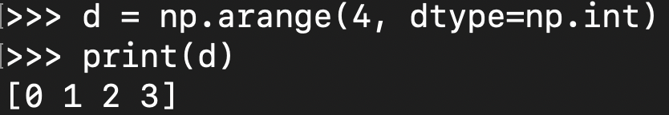
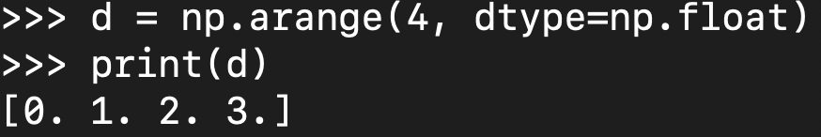
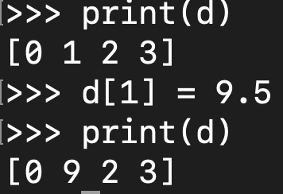
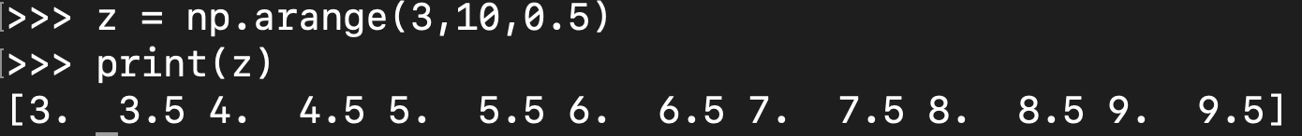
Numpy – Array Creation and Use
Generating an array similar to generating a list with range()
Generating an array with a float data type
Replacing elements with a different data type entry
Generating an array with arbitrary start, stop, and step
Notes:
19

Slide 20
Numpy – Array Methods
e = np.array([(1,2,3,4), (3,4,5,6)]) print(e.sum(axis=0))
[ 4 6 8 10]
Axis 0
8 | 9
10 | 11
12 | 13
Sum of axis 0: [30,33]
Axis 1
Sum of axis 1: [17, 21, 25]
Notes:
20

Slide 21
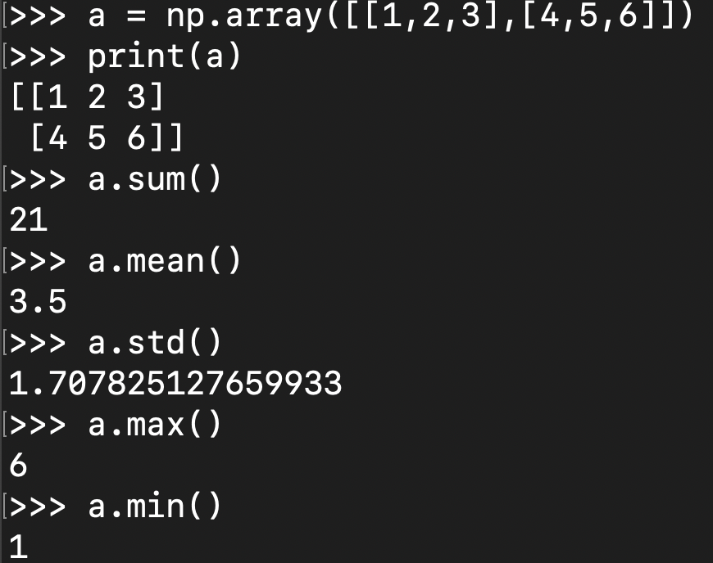
Numpy – Array Methods
Sum of all the elements
Mean of all the elements
Standard deviation of all the elements
Maximum element
Minimum element
Notes:
21

Slide 22
Numpy – Array Mathematics
>>> a = np.array([1,2,3], float)
>>> b = np.array([5,2,6], float)
>>> a + b
array([6., 4., 9.])
>>> a – b
array([-4., 0., -3.])
>>> a * b
array([5., 4., 18.])
>>> b / a
array([5., 1., 2.])
>>> a % b
array([1., 0., 3.])
>>> b**a
array([5., 4., 216.])
>>> a = np.array([[1, 2], [3, 4], [5, 6]], float)
>>> b = np.array([-1, 3], float)
>>> a
array([[ 1., 2.],
[ 3., 4.],
[ 5., 6.]])
>>> b
array([-1., 3.])
>>> a + b
array([[ 0., 5.],
[ 2., 7.],
[ 4., 9.]])
Notes:
22

Slide 23
Numpy – Array Functions
Most array methods have equivalent functions
>>> arr.sum()
45
>>> numpy.sum(arr)
45
Ufuncs provide many element-by-element math, trig., etc. operations
e.g., add(x1, x2), absolute(x), log10(x), sin(x), logical_and(x1, x2)
See http://numpy.scipy.org
Notes:
23

Slide 24
Matplotlib for data visualisation

Slide 25
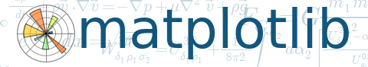
Plotting - matplotlib
User friendly, but powerful, plotting capabilities for python
Once installed (default at Observatory)
Notes:
25

Slide 26
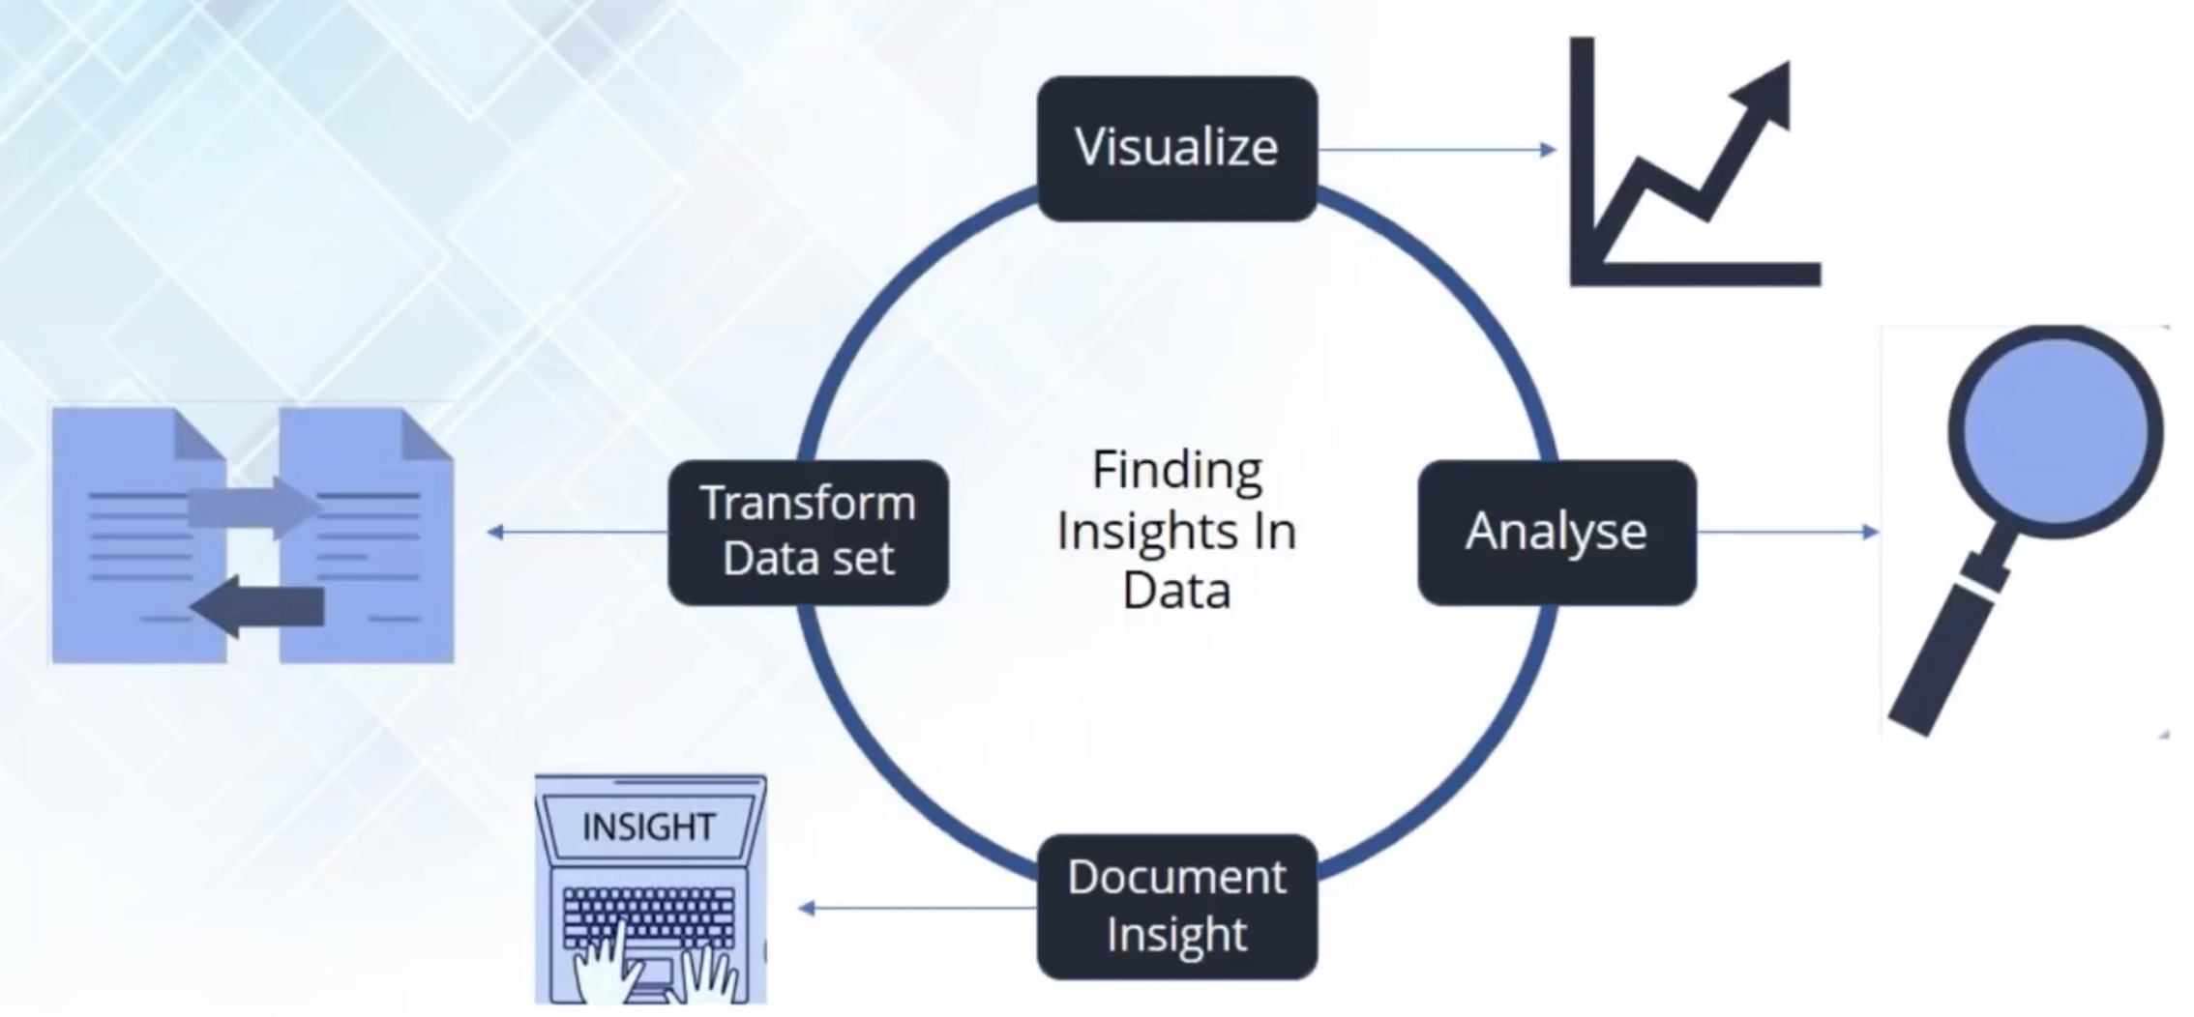
Data Visualisation
Data visualisation is a general term that describes an attempt to present a pictorial representation of the data to understand the significance of the data
It enables us to quickly interpret the important points in data and adjust different variables to observe their effect
Patterns, trends and correlations that might go undetected in text-based data can be recognized easier with data visualization
Notes:
26

Slide 27
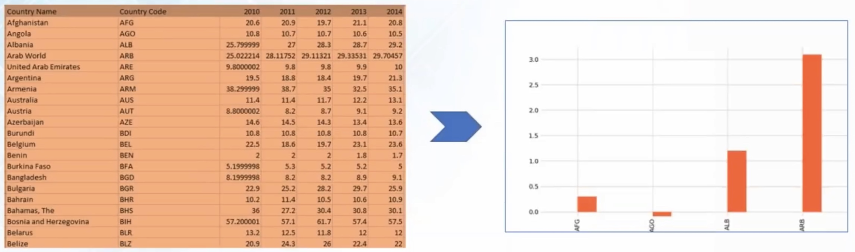
Data Visualisation - Matplotlib
Matplotlib is a Python package, used for 2D graphs
Graph below show a country-based percentage of unemployed youth
Notes:
27

Slide 28
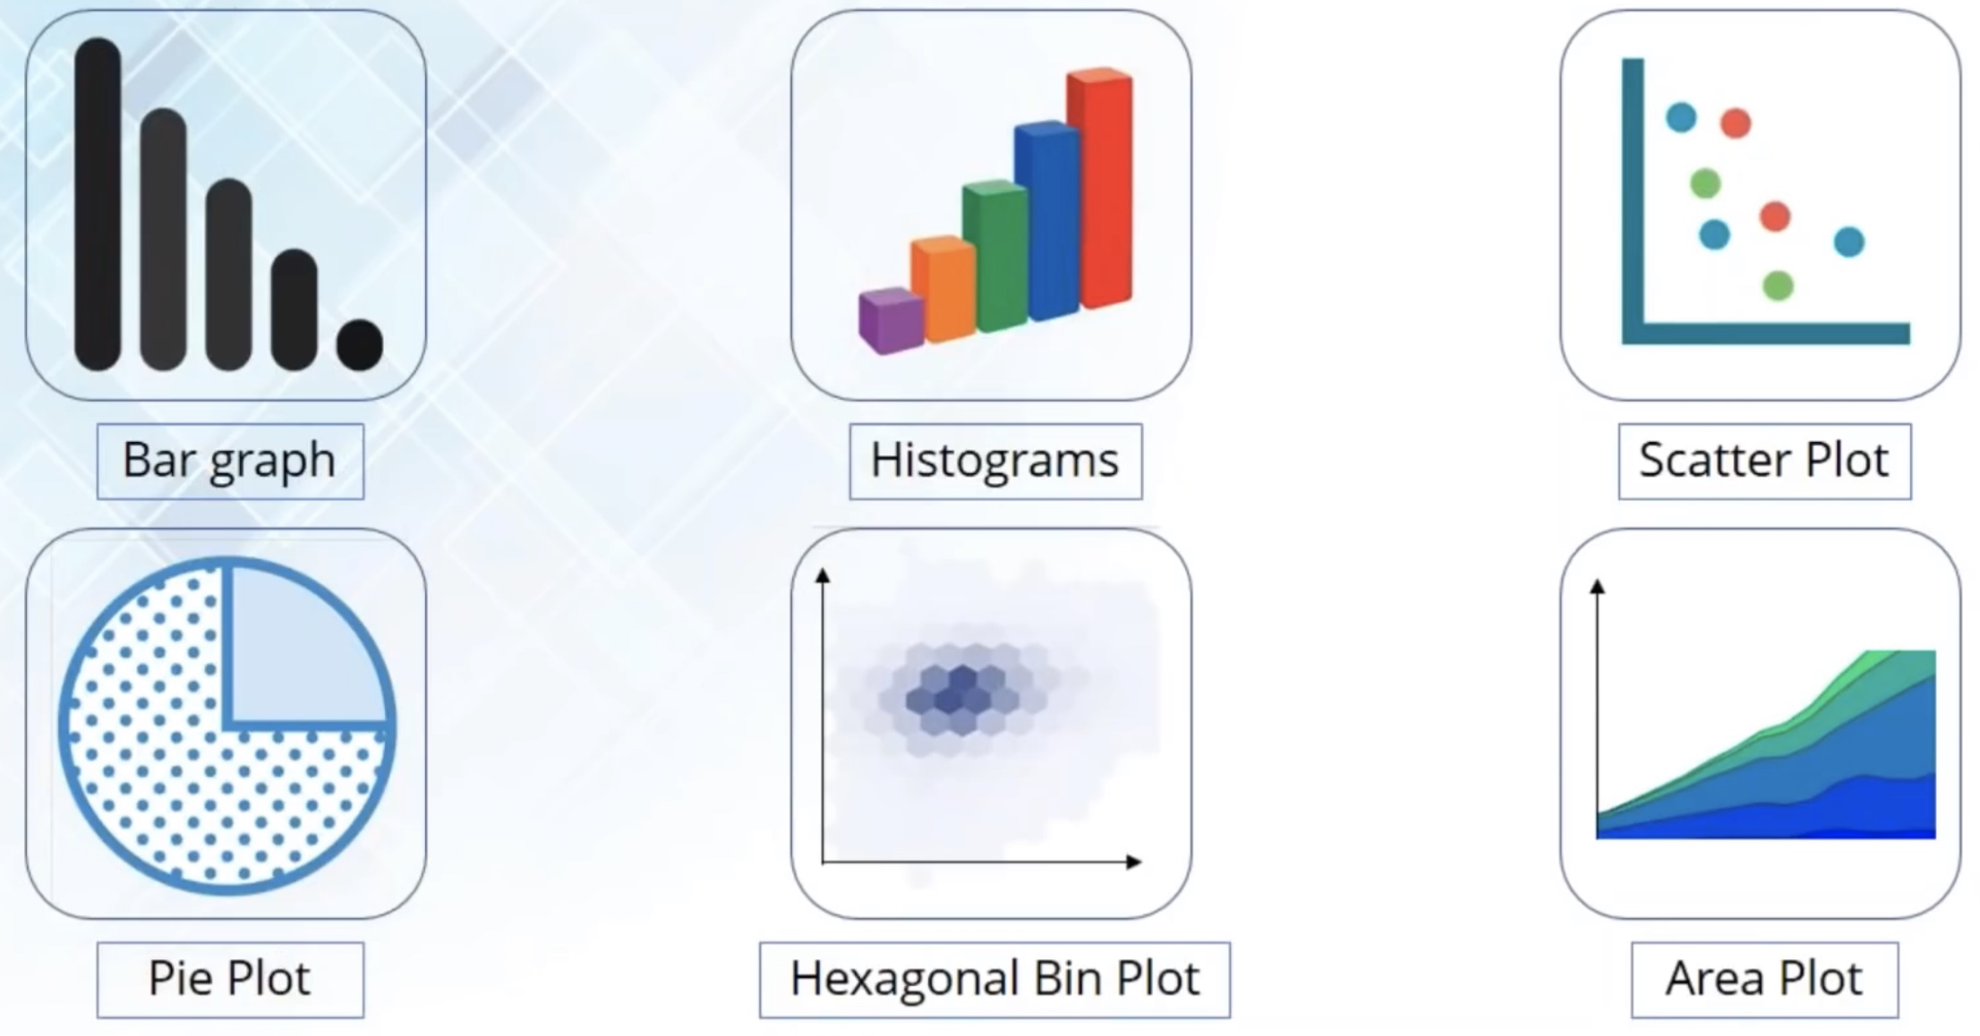
Data Visualisation - Matplotlib
Different types of plots

Slide 29
Graphics
Method | Description
distplot | histogram
barplot | estimate of central tendency for a numeric variable
violinplot | similar to boxplot, also shows the probability density of the data
jointplot | Scatterplot
regplot | Regression plot
pairplot | Pairplot
boxplot | boxplot
swarmplot | categorical scatterplot
factorplot | General categorical plot

Slide 30
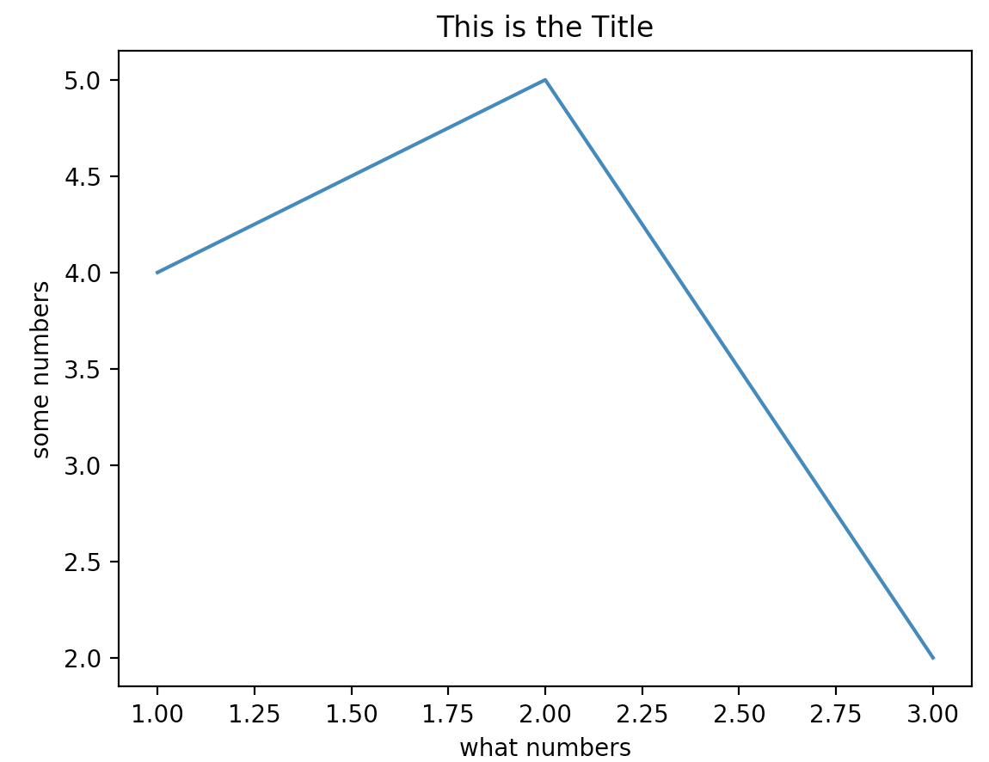
Matplotlib.pyplot – Simple Graph
import matplotlib.pyplot as plt plt.plot([1,2,3],[4,5,2])
plt.ylabel('some numbers’)
plt.xlabel(‘what numbers’)
Plt.title(‘This is the Title’)
plt.show()
matplotlib.pyplot is a collection of command style functions that enable Matplotlib generate different type of graphs. Each pyplot function makes some change to a figure: eg, create a figure, create a plotting area in a figure, plot some lines in a plotting area, decorate the plot with labels, etc....
Notes:
30

Slide 31
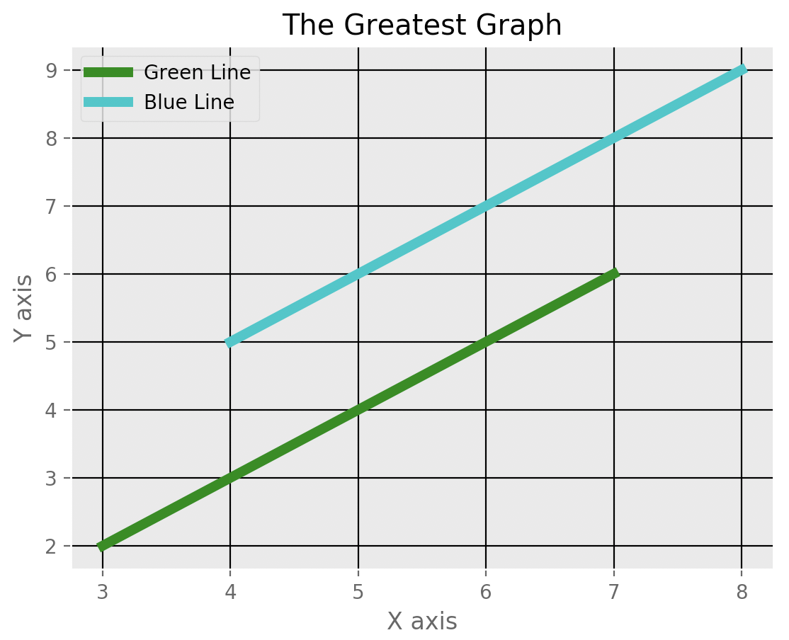
Matplotlib.pyplot – Adding Style
from matplotlib import style
style.use(‘ggplot’)
x = [3,5,7]
y = [2,4,6]
x2 = [8,6,4]
y2 = [9,7,5]
plt.plot(x,y,’g’,label=‘Green Line’,linewidth=5)
plt.plot(x2,y2,’c’,label=‘Blue Line’,linewidth=5)
plt.title(‘The Greatest Graph’)
plt.ylabel(‘Y axis’)
plt.xlabel(‘X axis’)
plt.legend()
plt.grid(True,color=‘k’)
plt.show()
Notes:
31

Slide 32
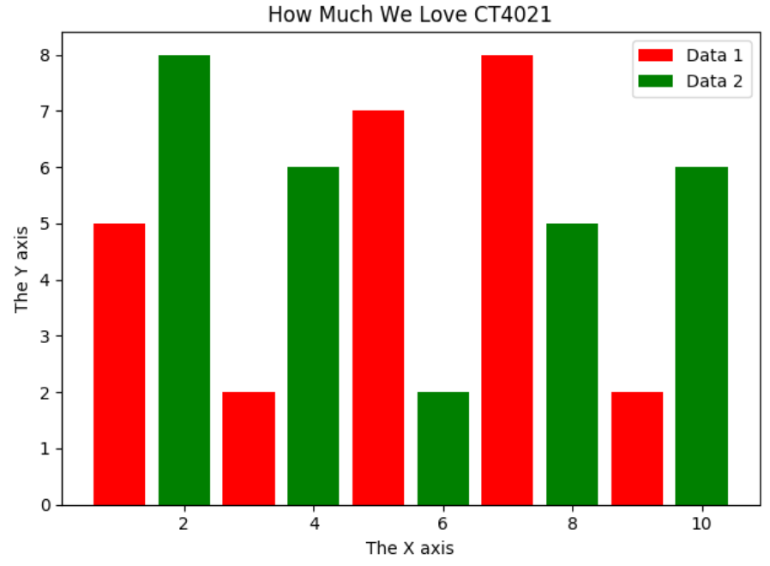
Matplotlib.pyplot – Bar Graph
import matplotlib.pyplot as plt
plt.bar([1,3,5,7,9],[5,2,7,8,2],label="Data 1",color='r')
plt.bar([2,4,6,8,10],[8,6,2,5,6],label="Data 2",color='g')
plt.title("How Much We Love CT4021")
plt.ylabel("The Y axis")
plt.xlabel("The X axis")
plt.legend()
plt.show()
Bar graph is primarily used for categorical data represented by rectangular bars, with heights or lengths proportional to the values that they represent. The bars can be plotted vertically or horizontally.
Notes:
32

Slide 33
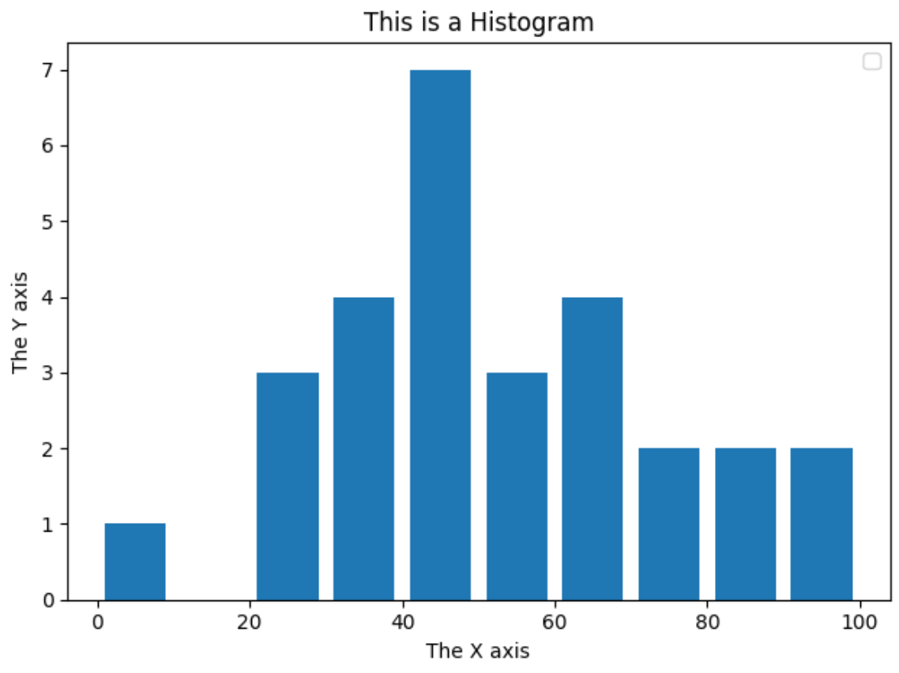
Matplotlib.pyplot – Histogram
import matplotlib.pyplot as plt
population_ages = [22,55,62,41,21,22,34,42,42,4,99,82,63,85,73,53,58,63,65,78,92,42,44,47,40,38,34,37]
bins = [0,10,20,30,40,50,60,70,80,90,100]
plt.hist(population_ages,bins,histtype='bar',rwidth=0.8)
plt.title("This is a Histogram")
plt.ylabel("The Y axis")
plt.xlabel("The X axis")
plt.legend()
plt.show()
Histogram is used to represent quantitative data .
Notes:
33

Slide 34
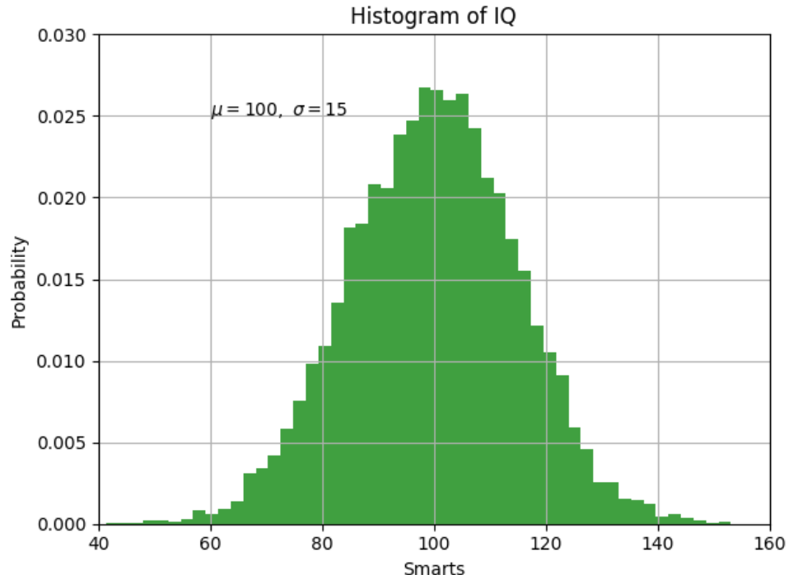
Matplotlib.pyplot – Numpy & text()
import numpy as np
import matplotlib.pyplot as plt
mu, sigma = 100, 15
x = mu + sigma * np.random.randn(10000)
# the histogram of the data
n, bins, patches = plt.hist(x, 50, density=1, facecolor='g', alpha=0.75)
plt.xlabel('Smarts')
plt.ylabel('Probability')
plt.title('Histogram of IQ')
plt.text(60, .025, r'$\mu=100,\ \sigma=15$')
plt.axis([40, 160, 0, 0.03])
plt.grid(True)
plt.show()
Working with text.
The text() command can be used to add text in an arbitrary location, and the xlabel(), ylabel() and title() are used to add text in the indicated locations.
Notes:
34

Slide 35


